Slide 1


KI - SAFE
WE value your privacy
FOUNDATIONS OF ARTIFICIAL INTELLIGENCE
GROUP 6

Slide 2
INDEX
S.NO. | TOPIC | PAGE
1. | INTRODUCTION | 3-4
2. | GUI AND WORKING EXPLAINED | 5-13
3. | PASSWORD MANAGER | 14
4. | PASSWORD GENERATOR | 15
5. | NOTES MANAGER | 16-18
6. | CONTRIBUTION | 19-20

Slide 3
How can our app help you?
We've created a Desktop app from where you can:
Manage different passwords along with websites/username/password.
Generate as much secure user ID and passwords as you need.
Notes Manager which can help you store your personal logs and messages and can access them later as you wish.
Play our space invader game for fun and entertainment.

Slide 4
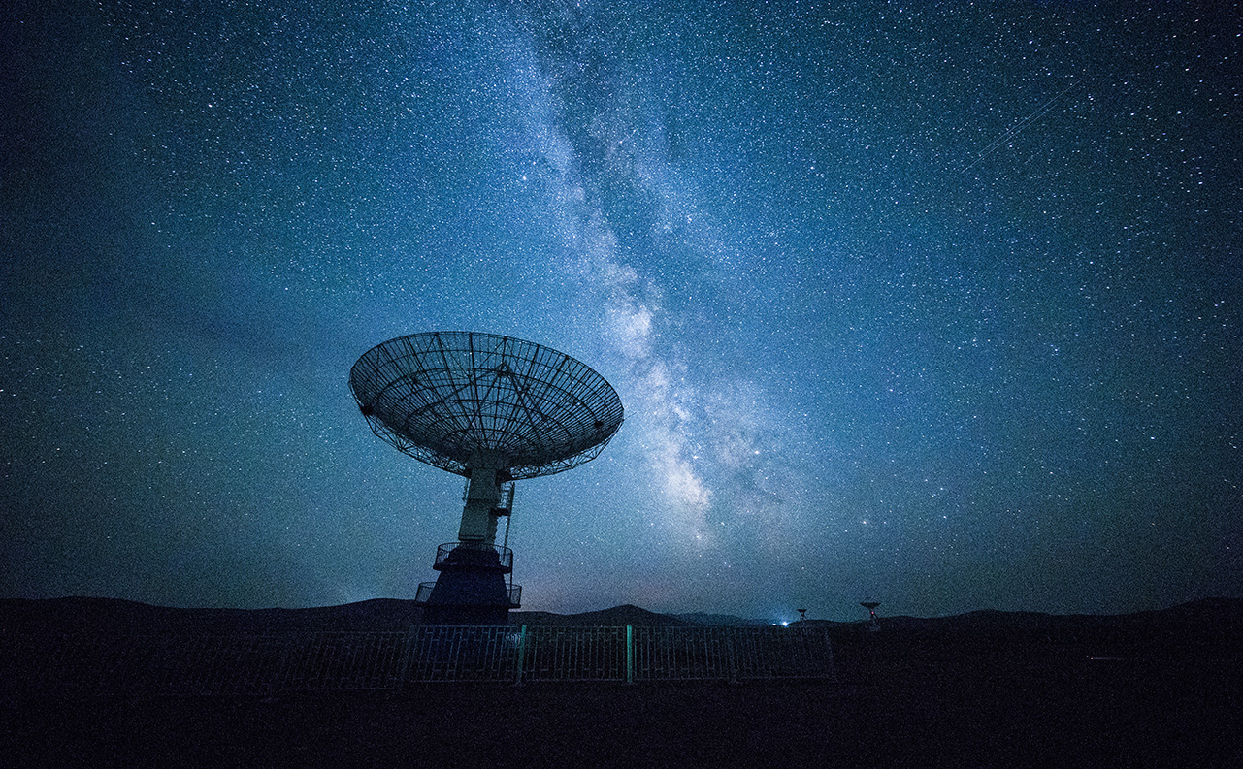

APP FEATURES
GUI
Generating Password
Managing Notes
Speech-to-text
Managing Password

Slide 5
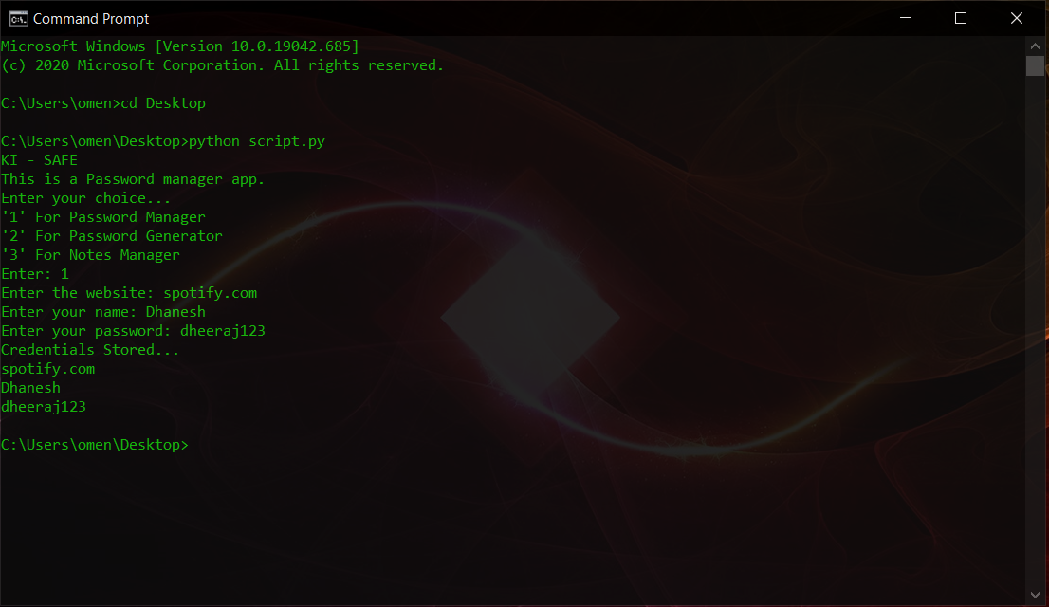
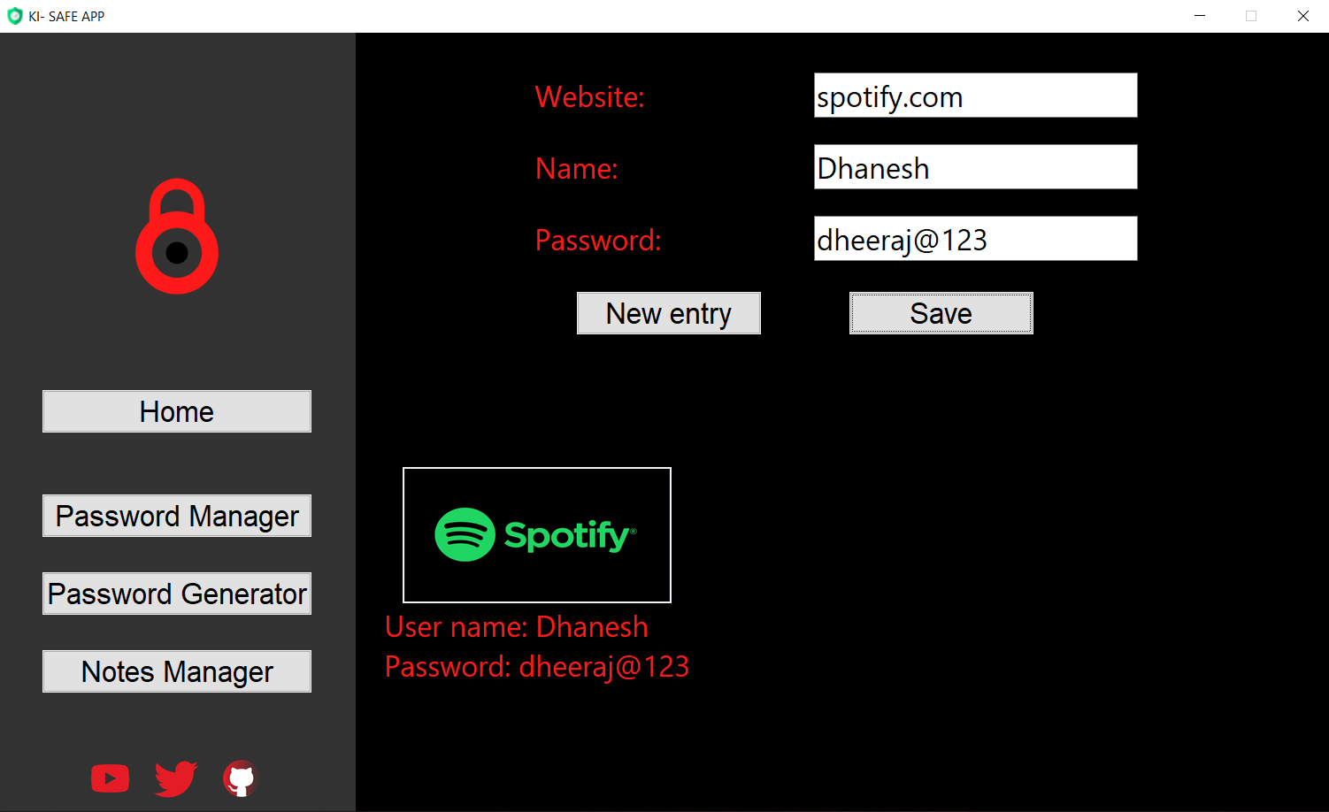
GUI
Before
After

Slide 6
WORKING OF APP
Root window
Nested Frames
Content Frame

Slide 7
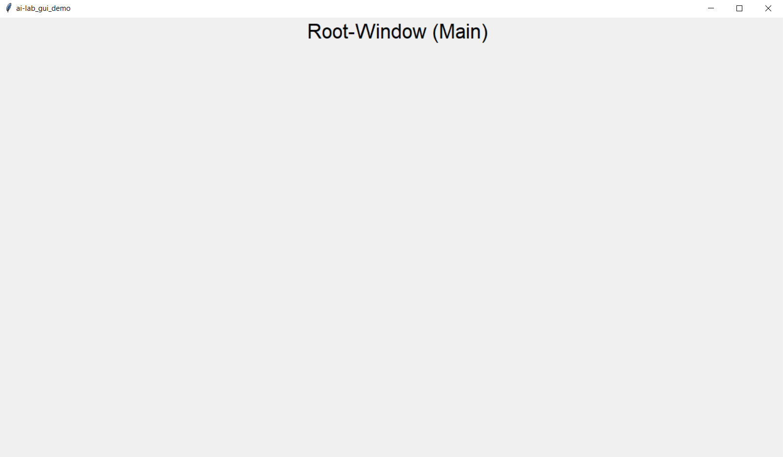
Main Window
It is the root point in the hierachy of the GUI

Slide 8
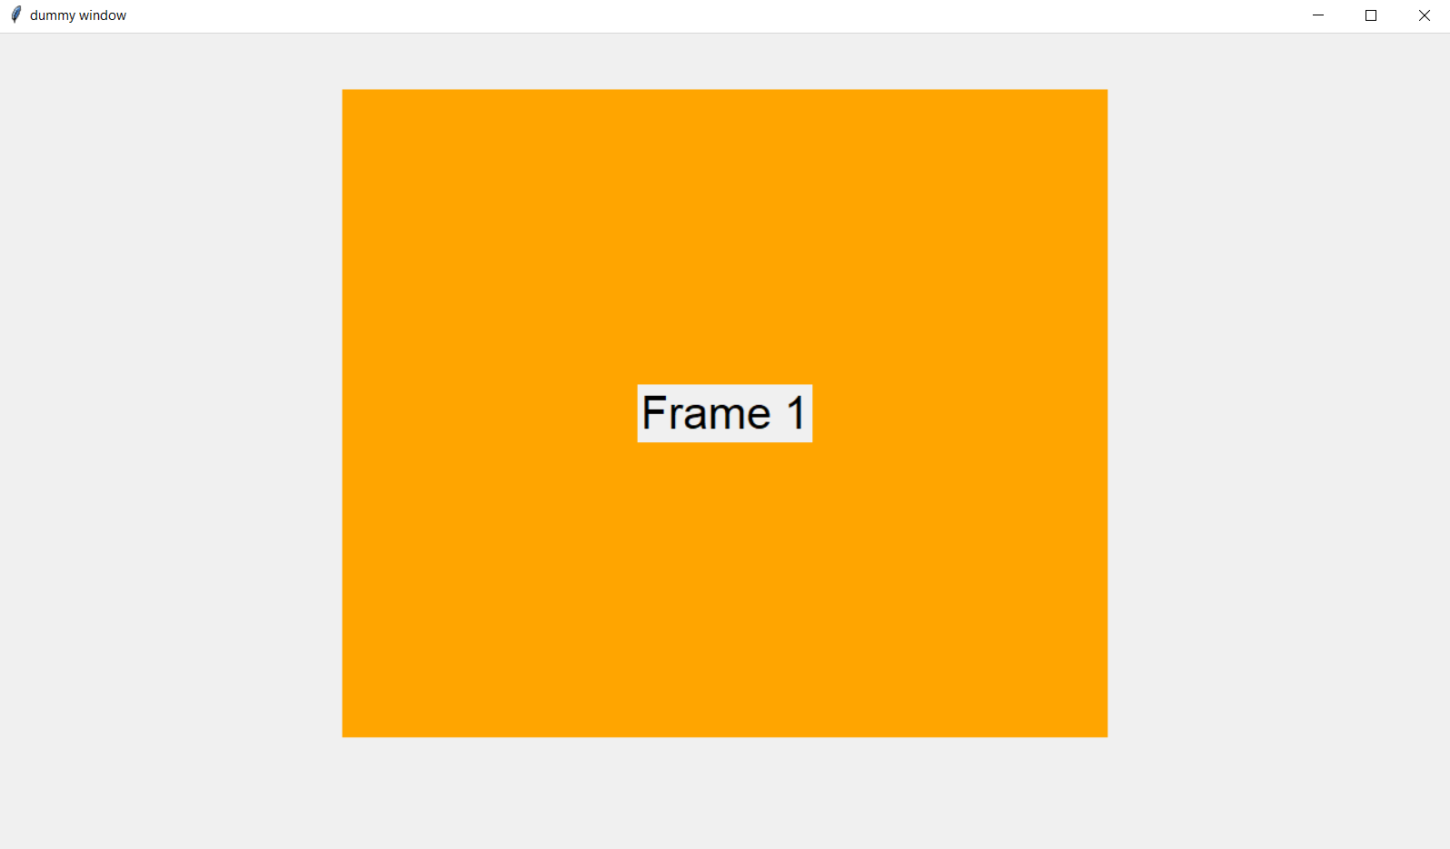
With one frame
This image displays the gui with one frame and label

Slide 9
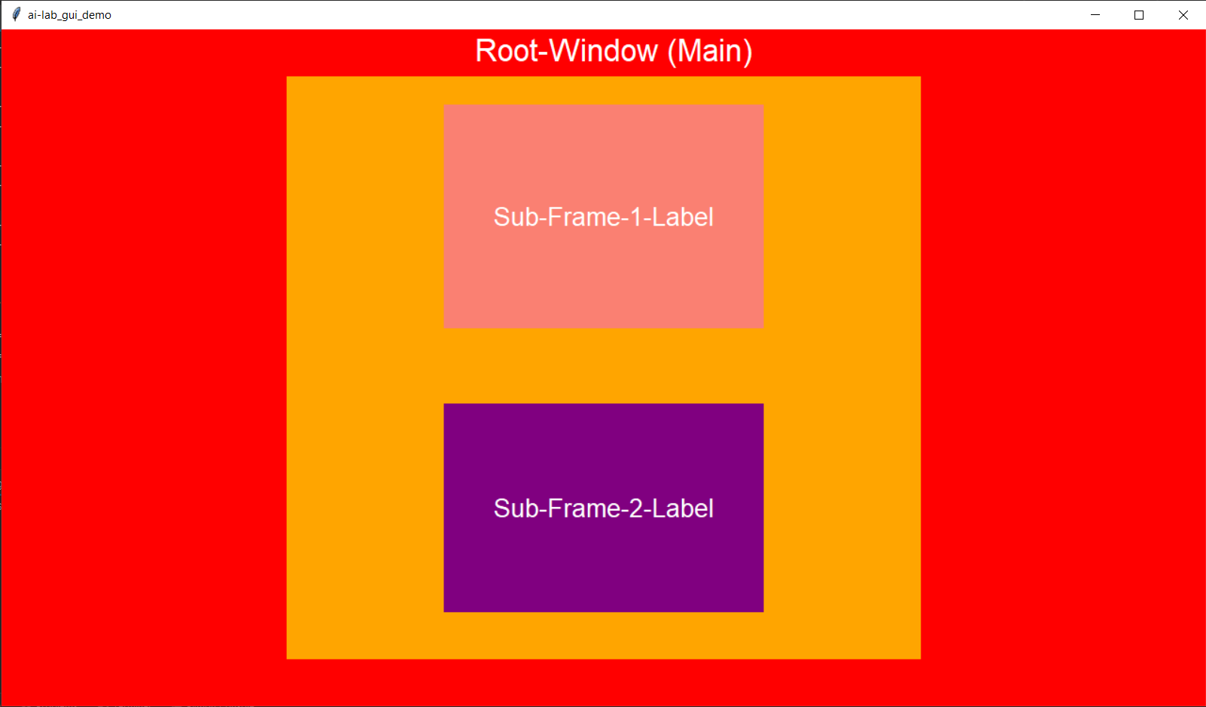
WITH MULTIPLE FRAMES
This image has a frame inside root and there are two nested frames inside the frame

Slide 10
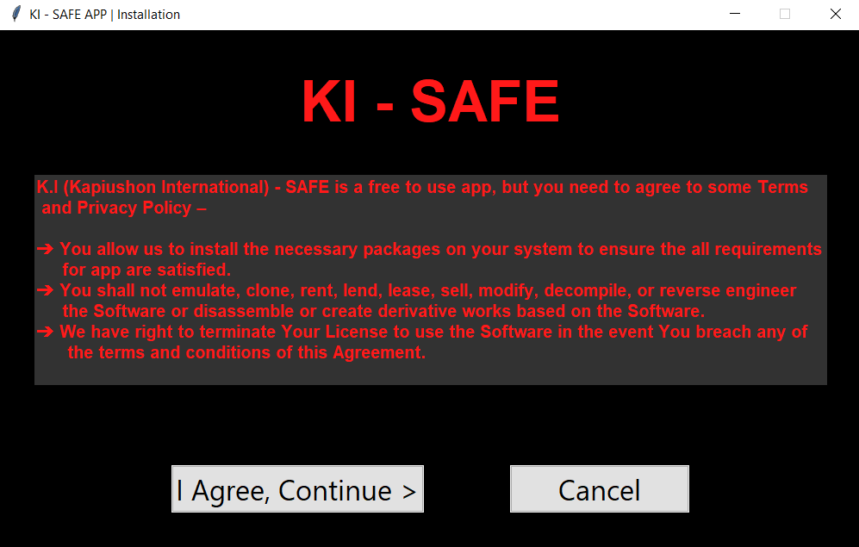
Assets | Installation
To make our app stand-alone we've used urlib module that scrapes the images from internet and stores into a folder and then uses them.
We've used subprocess module to install all the neccesary modules at the time of starting app for first time.

Slide 11
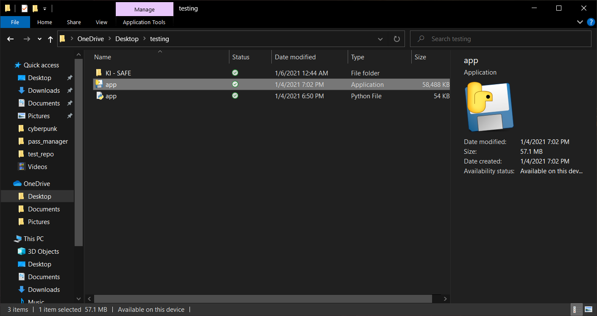
EXECUTION
Here you can see we can use .py file or .exe to open our app.
There is a KI – SAFE folder in this directory, which stores all the media files, logos, icons and some saved user credentials.

Slide 12
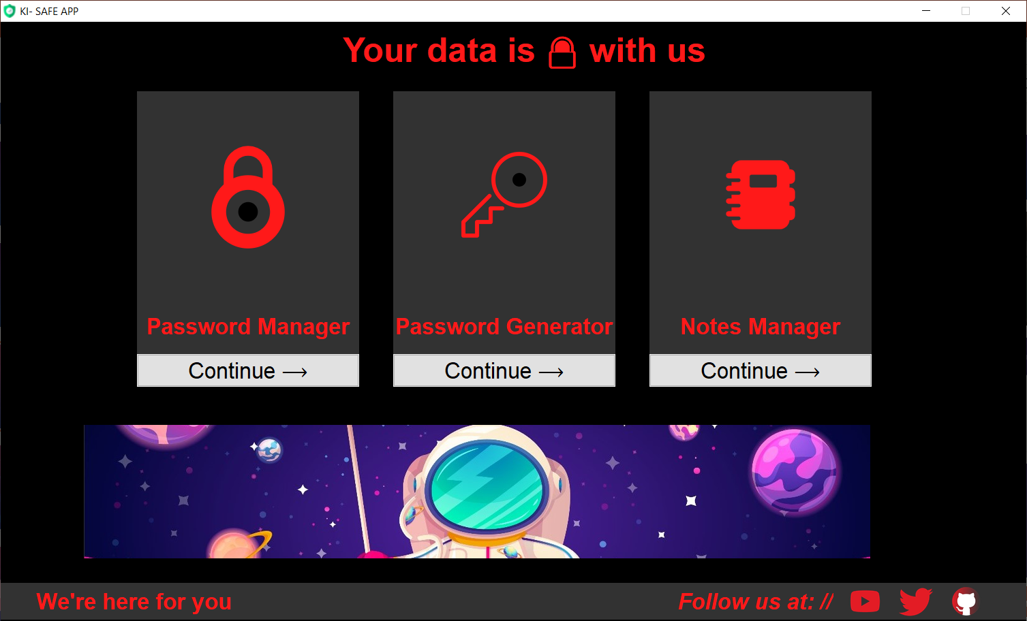
homepage
This is the home page view and has three main sections namely Password Manager, Password Generator and Notes Manager.
Along with that there is a game for entertainment and fun.
We have used frames, icons, hyperlinks and buttons.

Slide 13
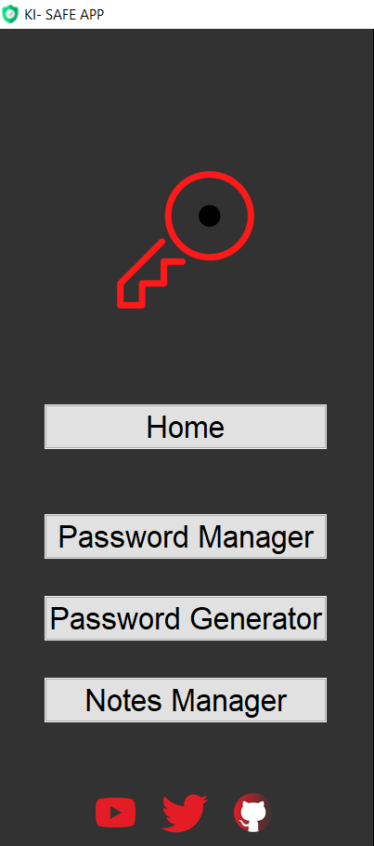
App navigation menu
Here we have used list type menu, through which we can navigate to anywhere in the app.
The menu also contains the current window icon.
It also displays the different hyperlinks for the socail media platforms where you can find us.

Slide 14
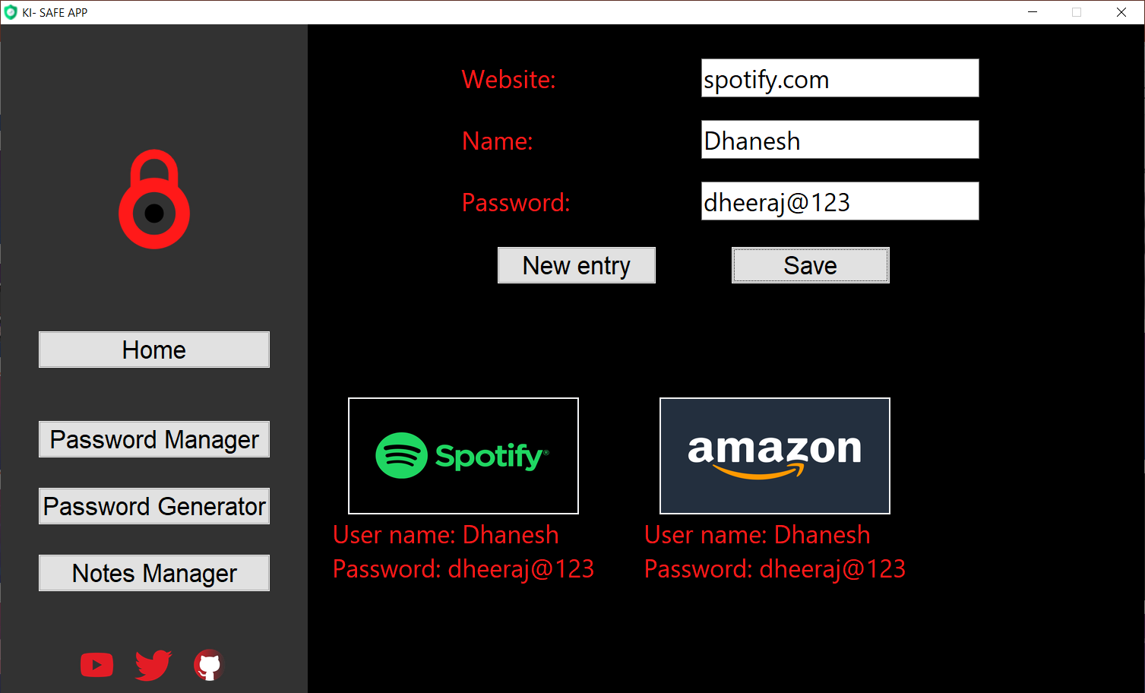
Password manager
A password manager is a computer program that allows users to store, generate, and manage their personal passwords for online services.
There are three input fields website, name and password and save button to store them.
The individual passwords are shown in frame along with their details in the bottom of the app screen.

Slide 15
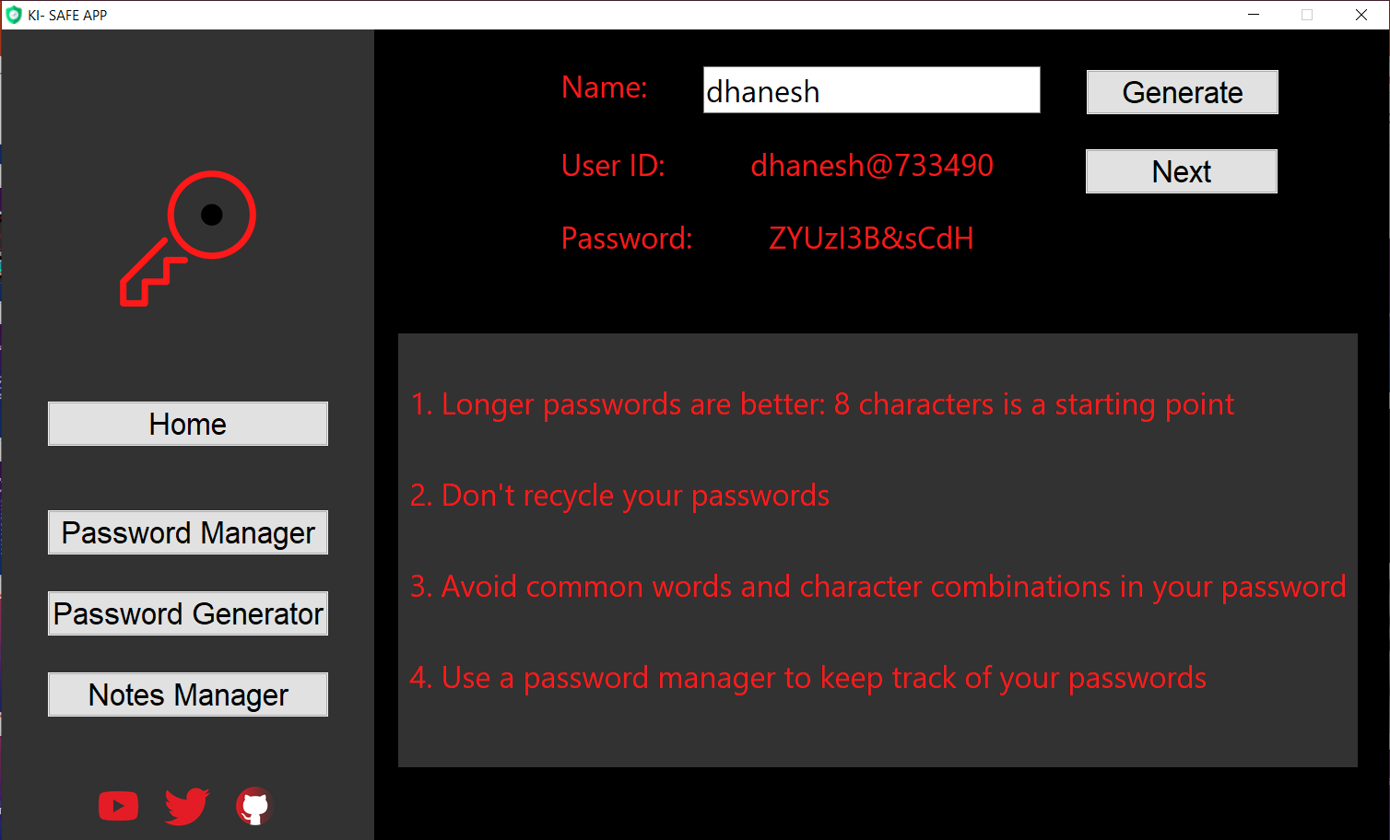
PASSWORD GENERATOR
In PASSWORD GENERATOR we use the Random module,when the users type the name,the user I'd and password are suggested by the app.
When users click on the next button then different unique combination of passwords and user I'd are suggested by the app.

Slide 16
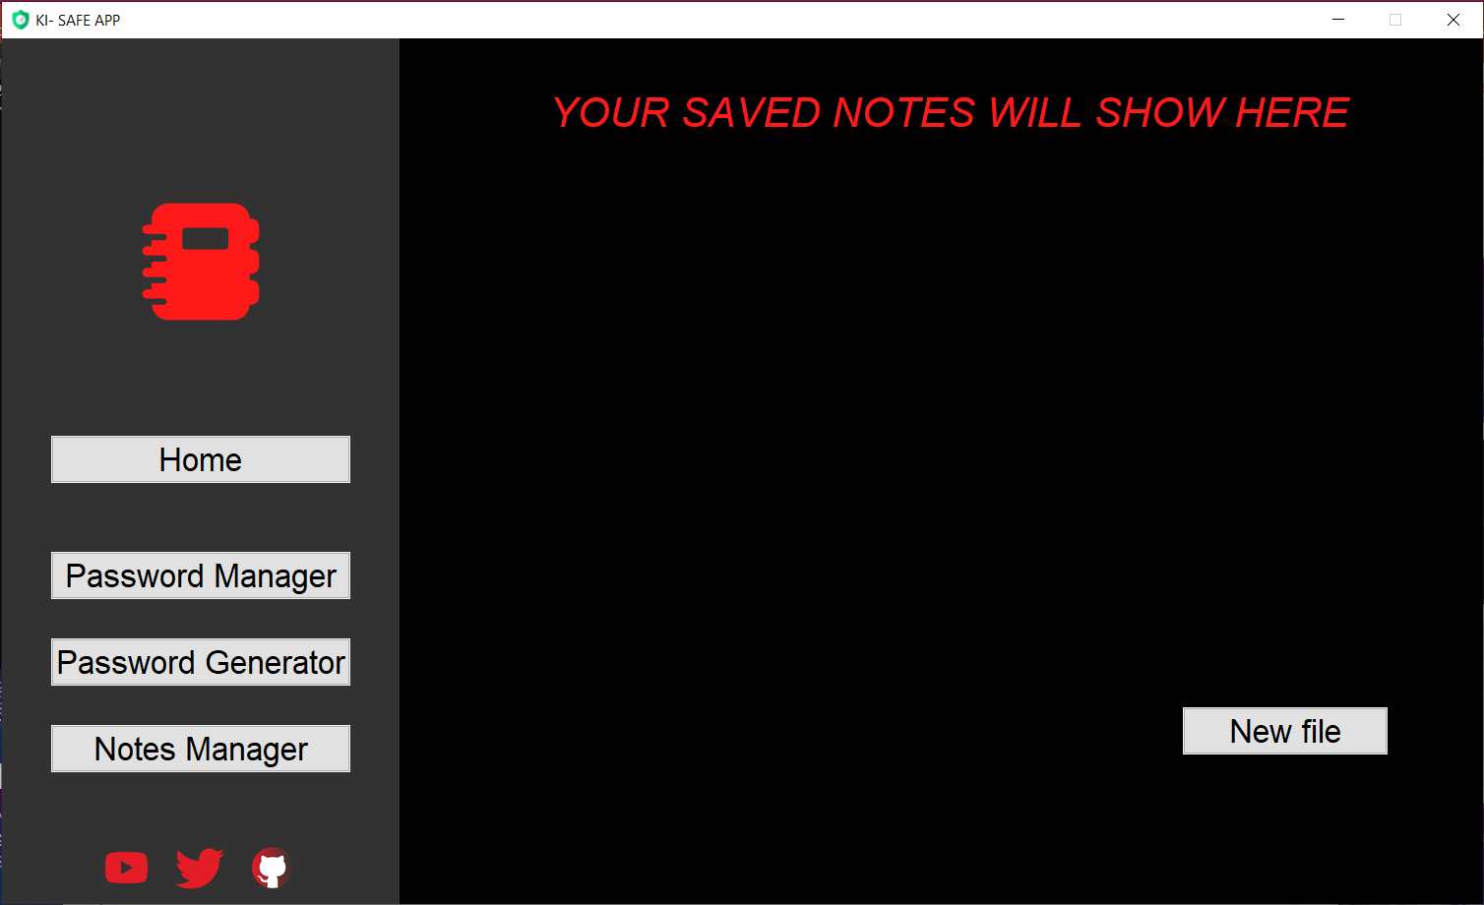
NOTES MANAGER
A person has to maintain a diary to keep track of all the work that has to be completed effectively and on time. It becomes difficult to maintain the list of tasks manually in an efficient manner. Hence a computerized system needs to be generated that will keep track of the complete information about an individual’s task. This notes manager feature does just that. We use new button to create new file.

Slide 17
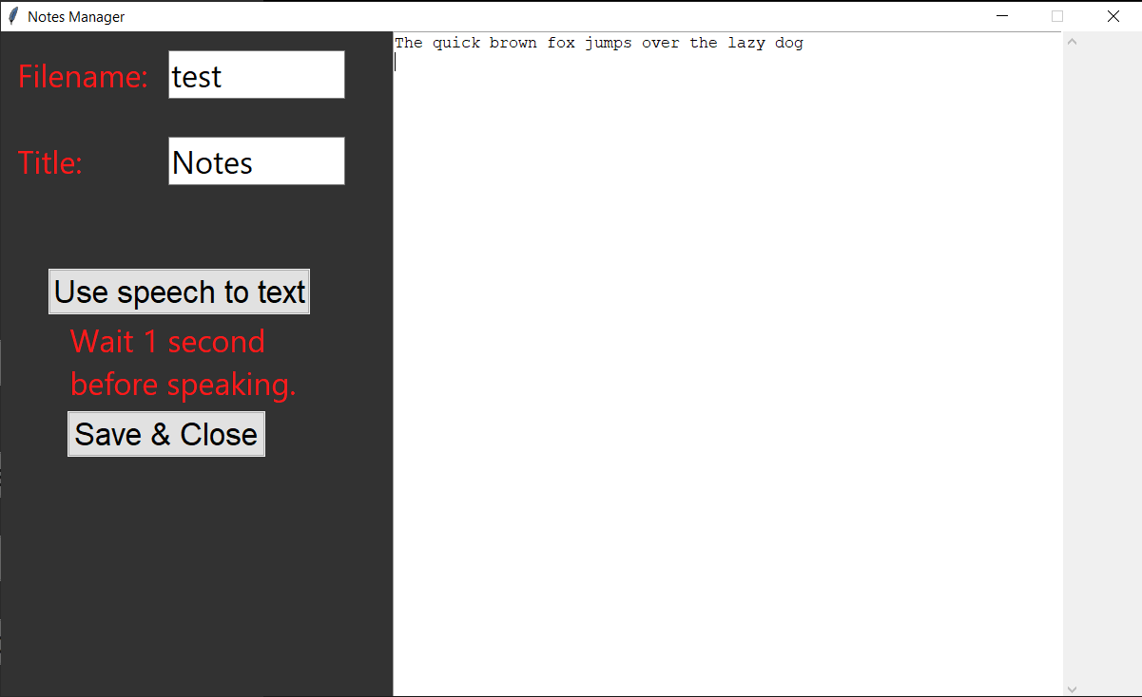
Notes manager
Here we need to enter the file name and title, along with all the content we want to save in our note.
We can either type in or use speec_to_text module in python.
After finishing the note we can use Save & Close button to save the file.

Slide 18

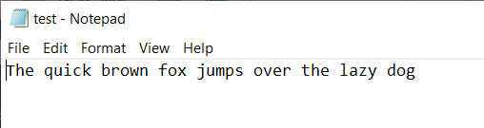
NOTES MANAGER
As you can see all the files we save they are shown in the app with hyperlink that can open the files in notepad.
The files are saved along with time using datetime mofule in python and also displayed in the app.

Slide 19

CONTRIBUTIONS

Slide 20
CODE DEVELOPERS
DHANESH LAKHANI, SANDEEP SHAW, SABAHUL MUNZARIN, PARMAR AKSHAT BHANUPRASAD
WORKSHEET/PPT
DHANESH LAKHANI, SIKANDAR SIDDIQUEE, ROHAN GODHA
RESOURCE COLLECTOR
DHANESH LAKHANI, SIKANDAR SIDDIQUEE
TEAM MANAGEMENT
DHANESH LAKHANI, ROHAN GODHA
APP TESTING
DHANESH LAKHANI, ROHAN GODHA, SABAHUL MUNZARIN
IDEAS MANAGEMENT
DHANESH LAKHANI, ROHAN GODHA

Slide 21

Thank You!
KI – SAFE TEAM

